Slide 1
Optics Transmission Update
23.10.25

Slide 2
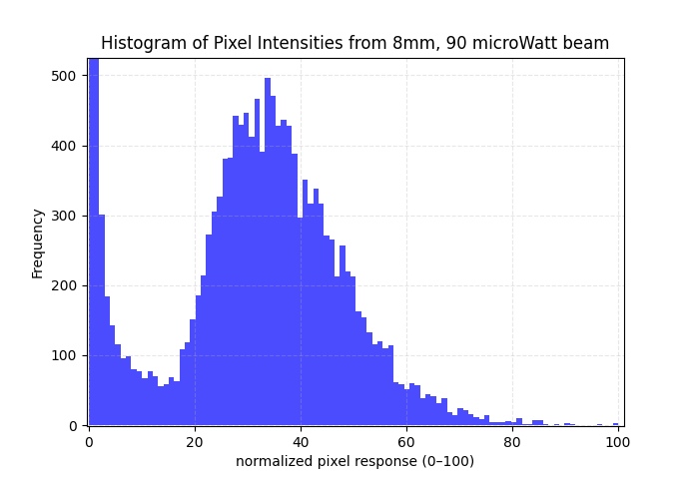
Importance of Exposure
Niko estimated the transmission through the rings to be 1.9% and 3%
This requires ~100x “dynamic range”
Due to the paper structure*, given a single exposure time, there is only a range of ~3x
*and maybe something else

Slide 3
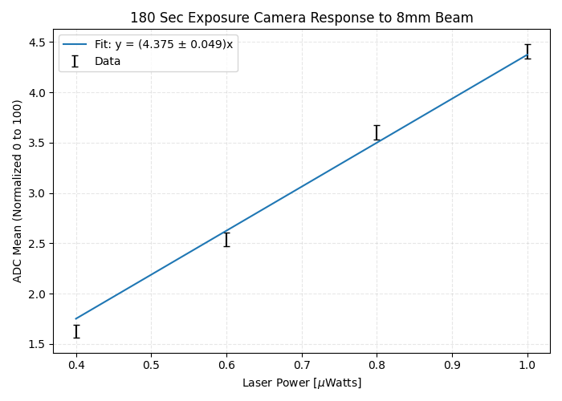
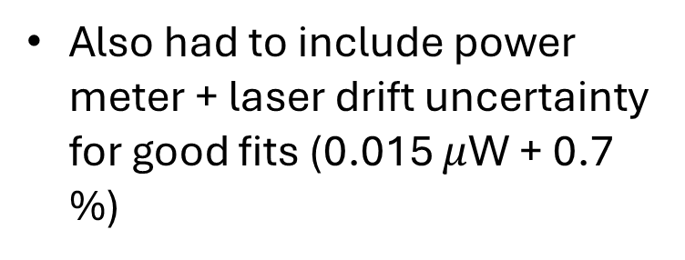
Exposure Test
Tested Exposure Times from 1 sec to 3 min
Initial linear fits statistically failed, but carefully controlling the repositioning of the camera corrected this.
Also had to include power meter + laser drift uncertainty for good fits (0.015 $μ$W + 0.7 %)

Slide 4
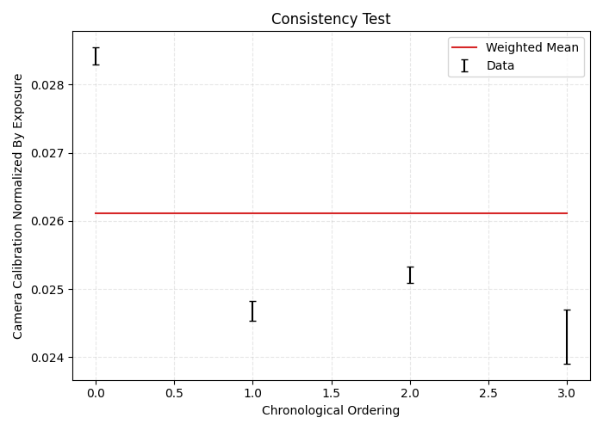
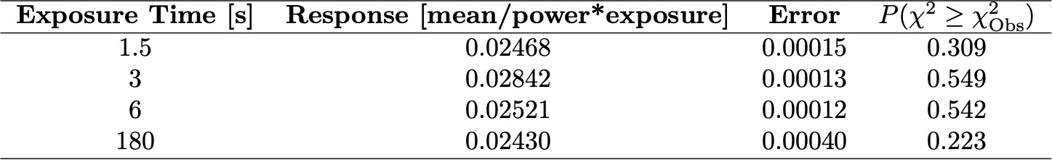
Results
Tested Exposure Times from 1 sec to 3 min
3 sec (last weeks data)
All of them consistent to at least 3%
1.5 sec
The data set with better controlled positioning gave ~0.5% consistency
6 sec
180 sec

Slide 5
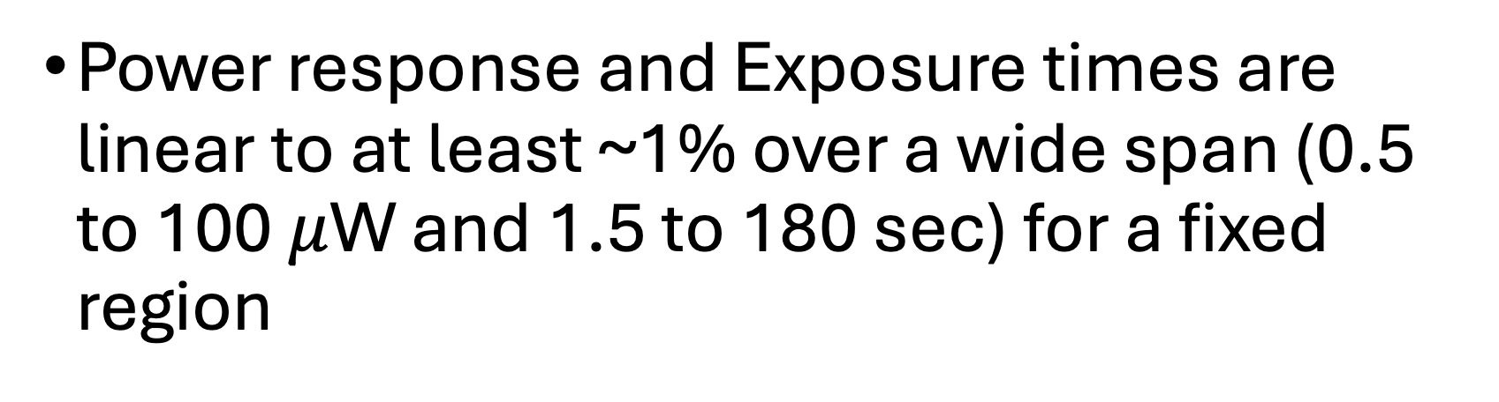
Summary
Power response and Exposure times are linear to at least ~1% over a wide span (0.5 to 100 $μ$W and 1.5 to 180 sec) for a fixed region
How do different regions compare?

Slide 6
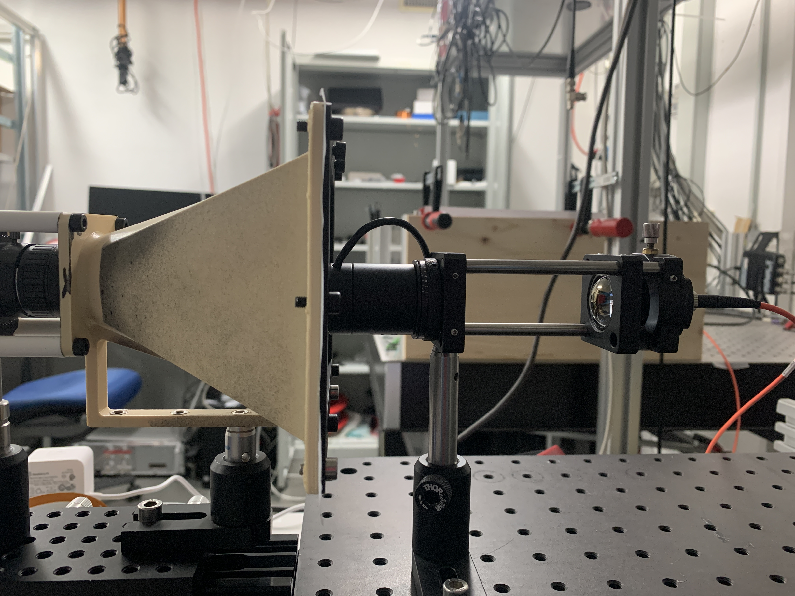
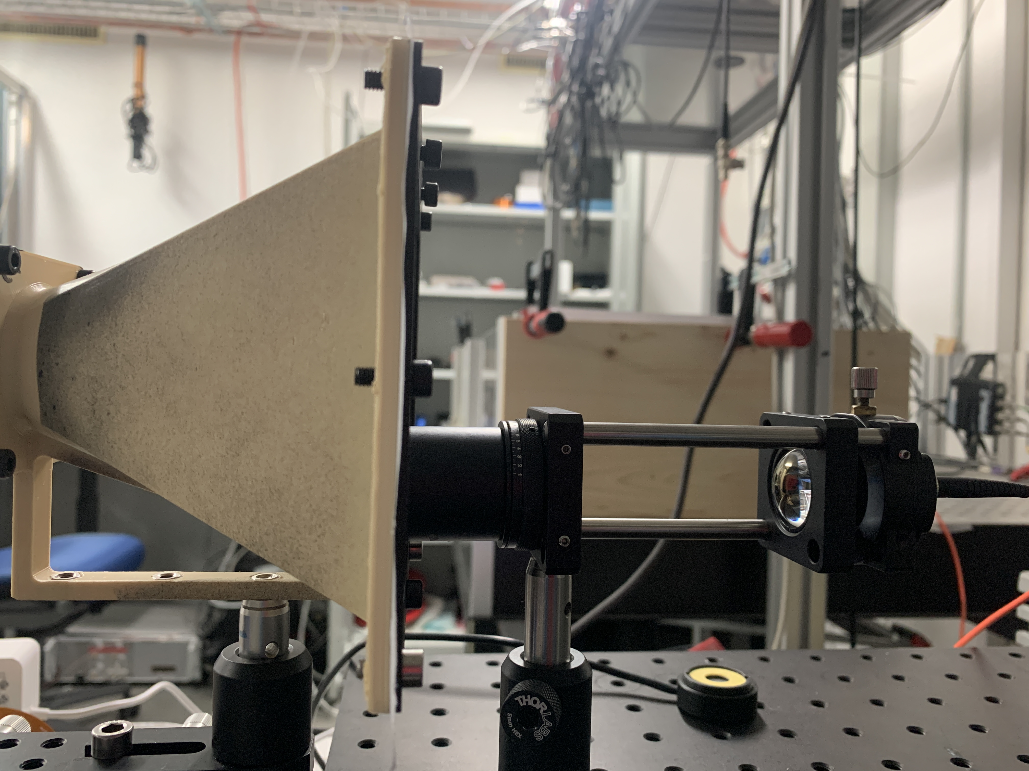
Positioning Test

Slide 7
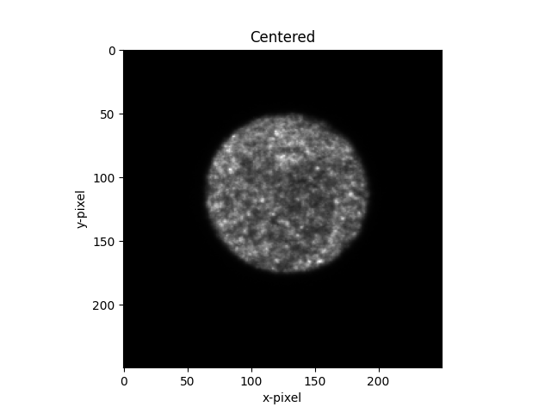
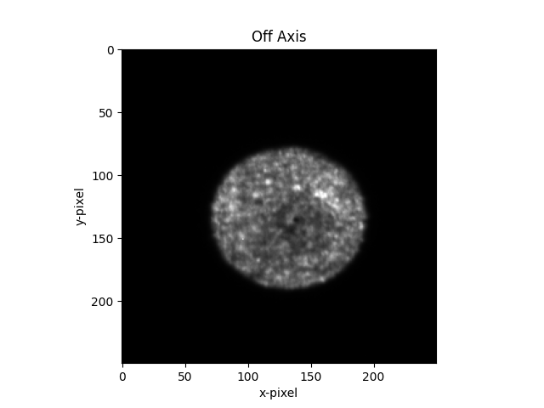
Off Center Blur

Slide 8
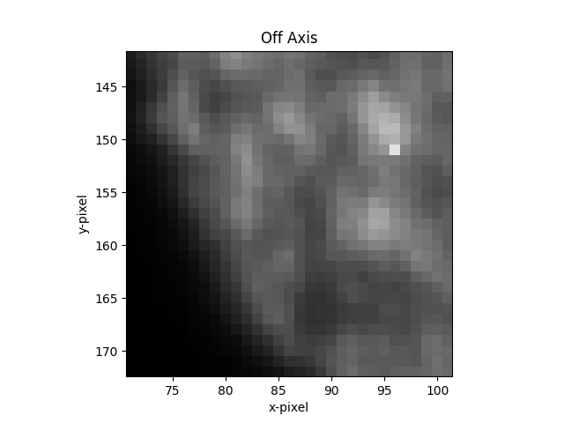
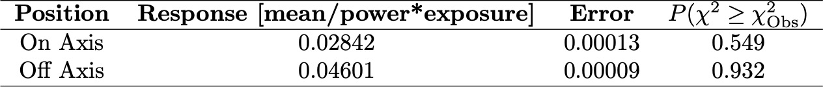
Yikes
suspicious
Calibrations are a factor of 1.5 different (~132$σ$)
Maybe a camera focus effect or different pixels

Slide 9
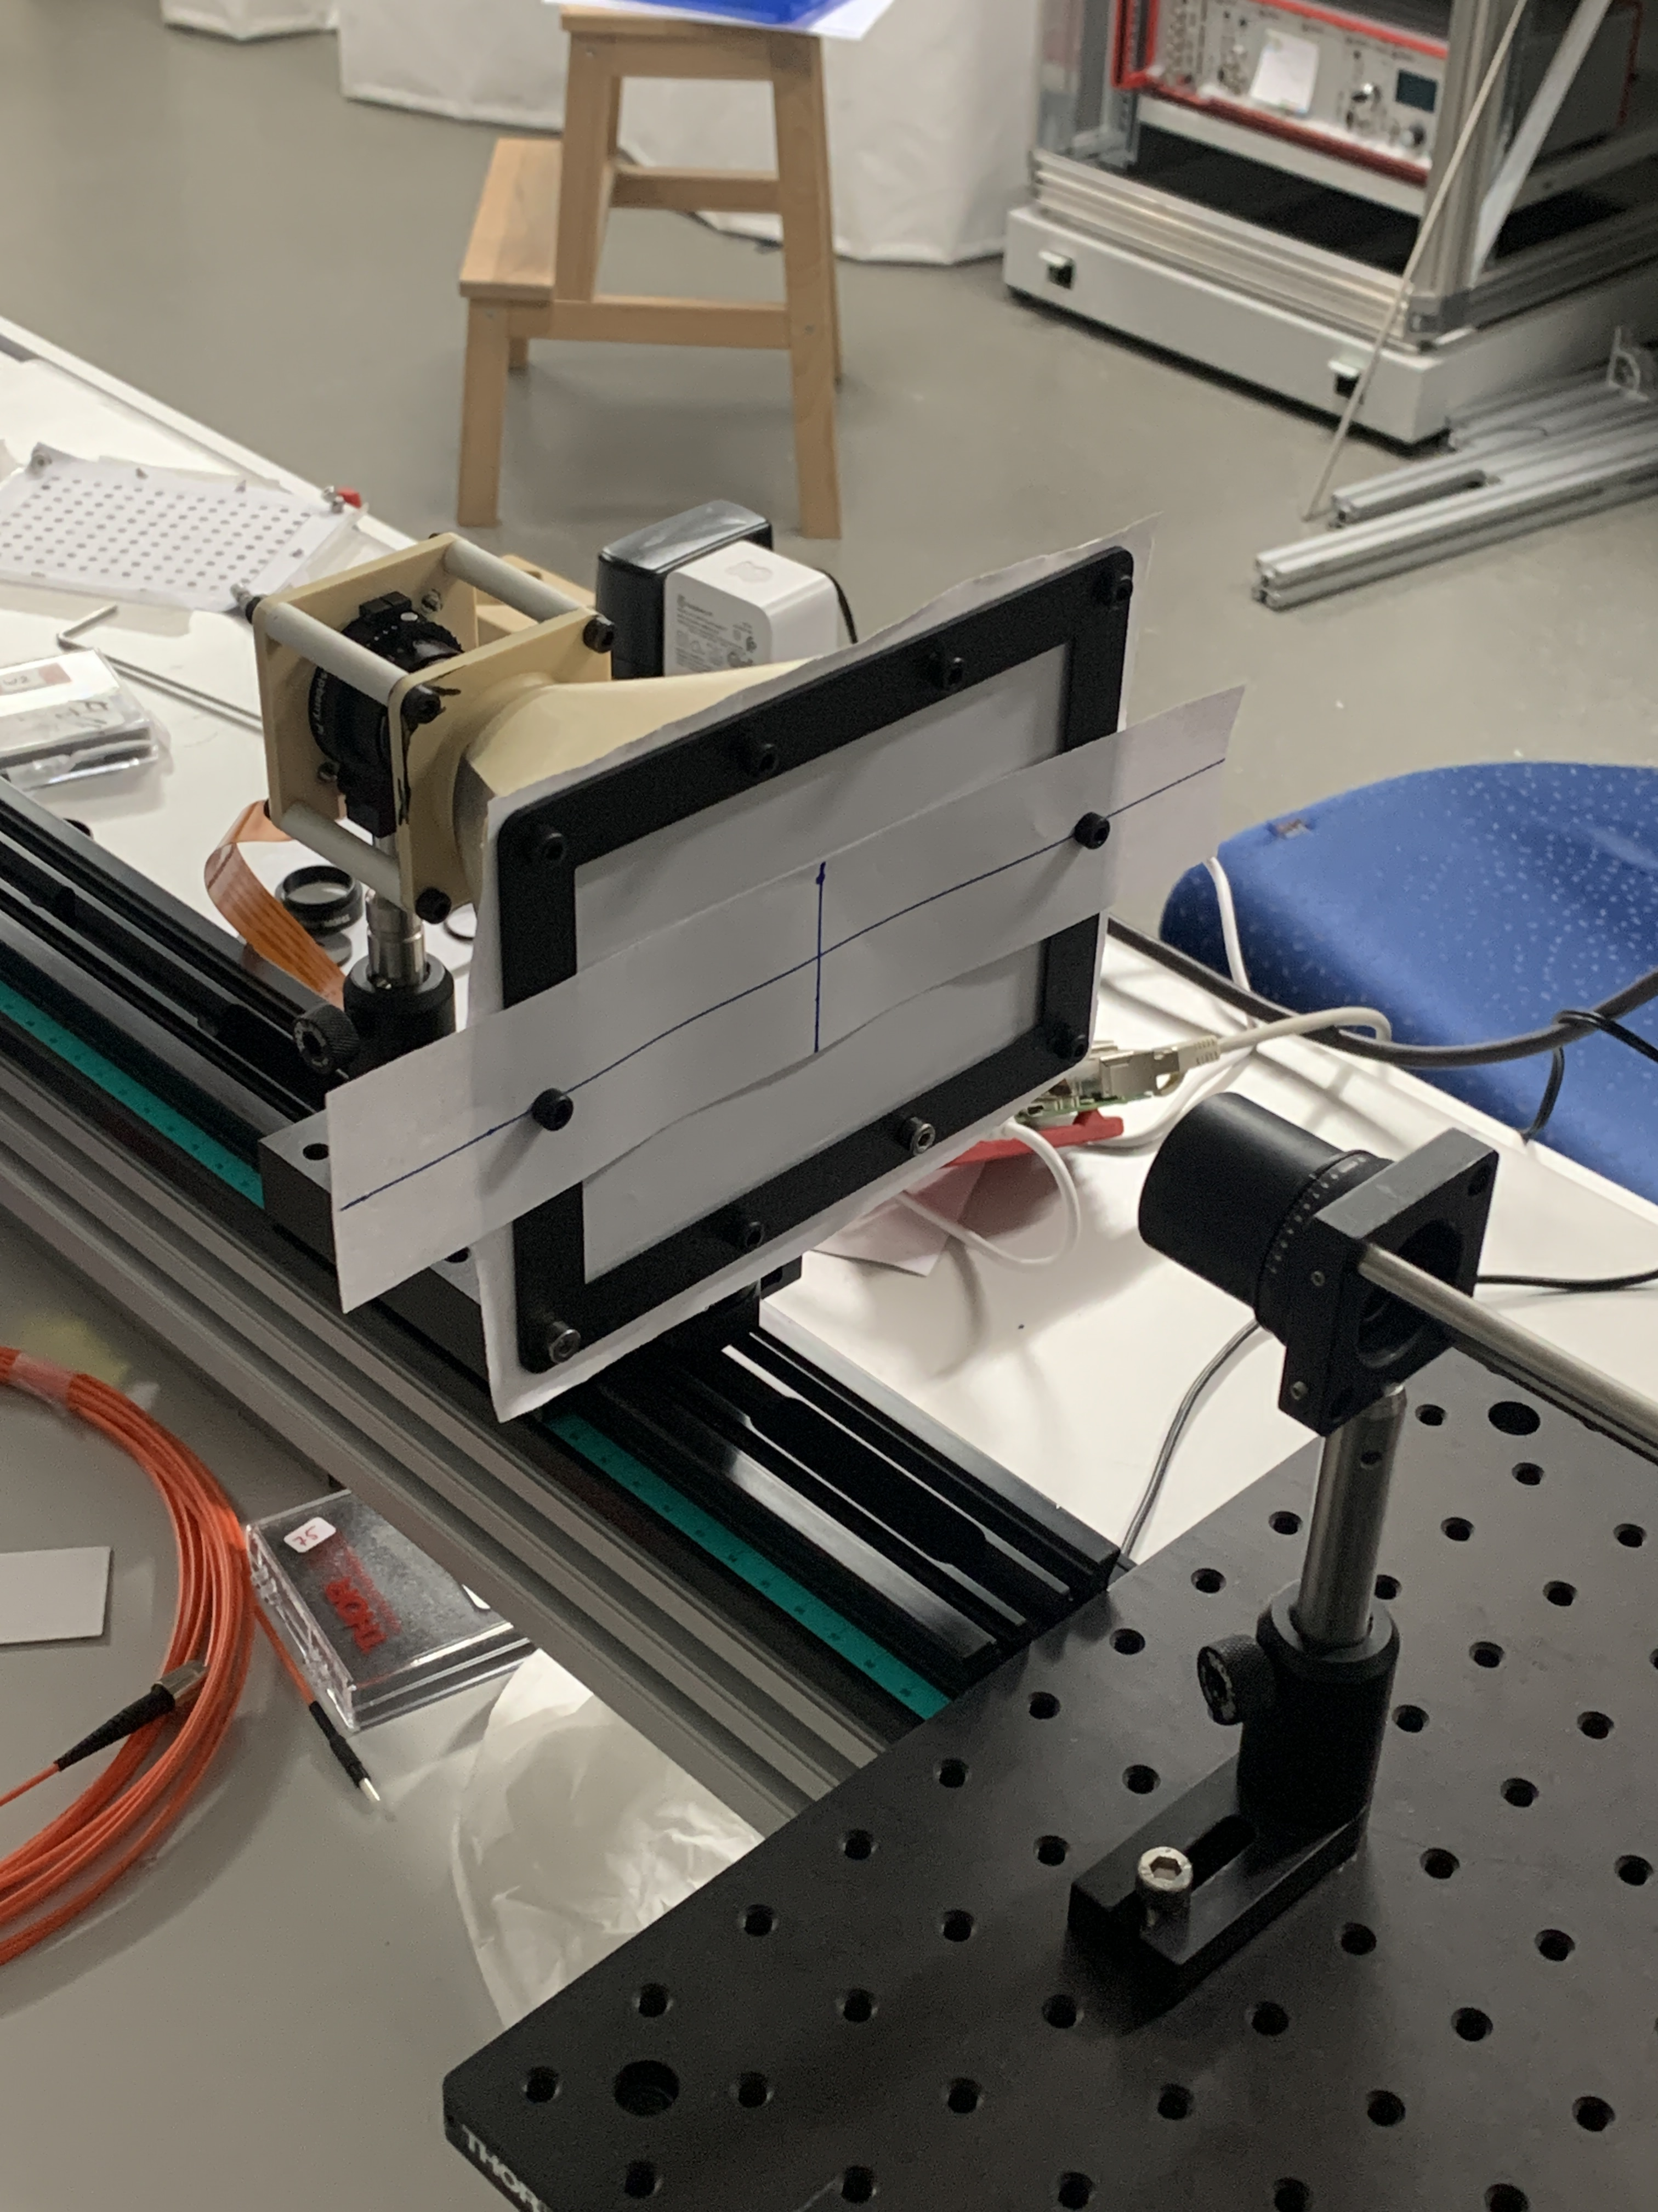
Next Step: Large Beam Calibration? Beam Divergence

